Slide 1

Linked Lists
Chris Piech
CS 106B
Lecture 14
Feb 8, 2016

Slide 2

恭禧发财

Slide 3



Midterm

Slide 4

Open Computer?

Slide 5
Open Computer?
Conclusion: No open computers.

Slide 6
Midterm Questions?

Slide 7
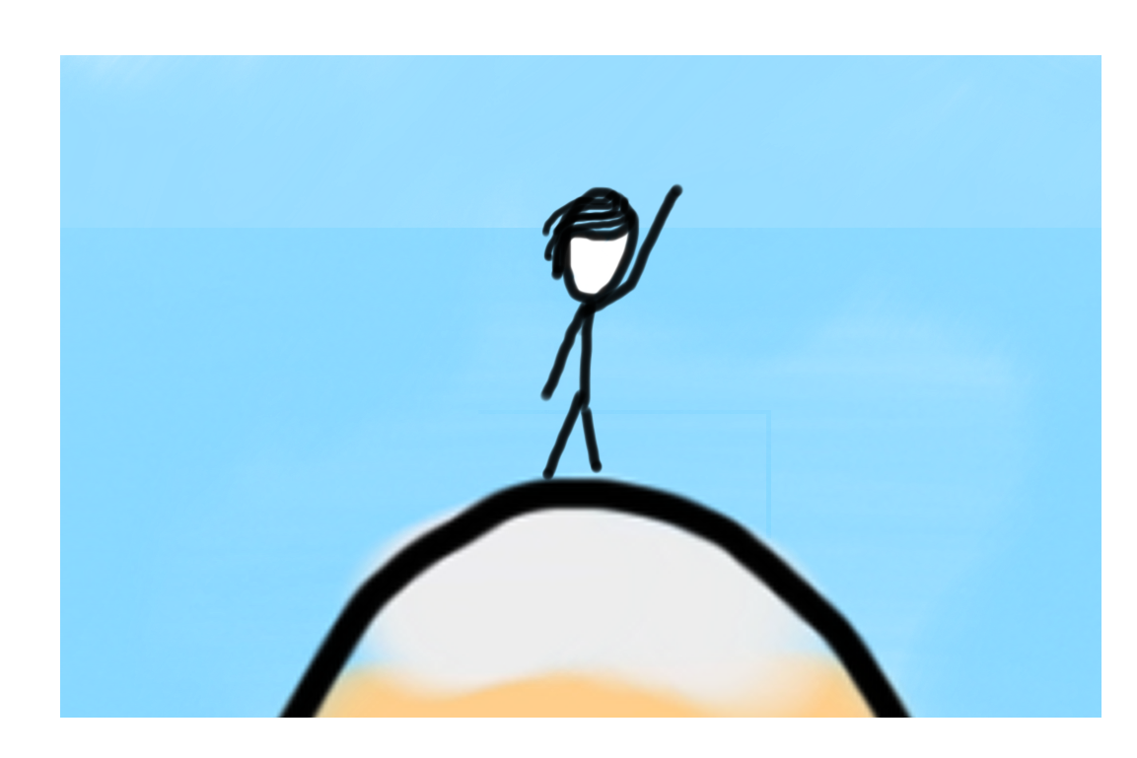
Today’s Goals
Practice with dynamic allocation
Introduction to linked lists

Slide 8
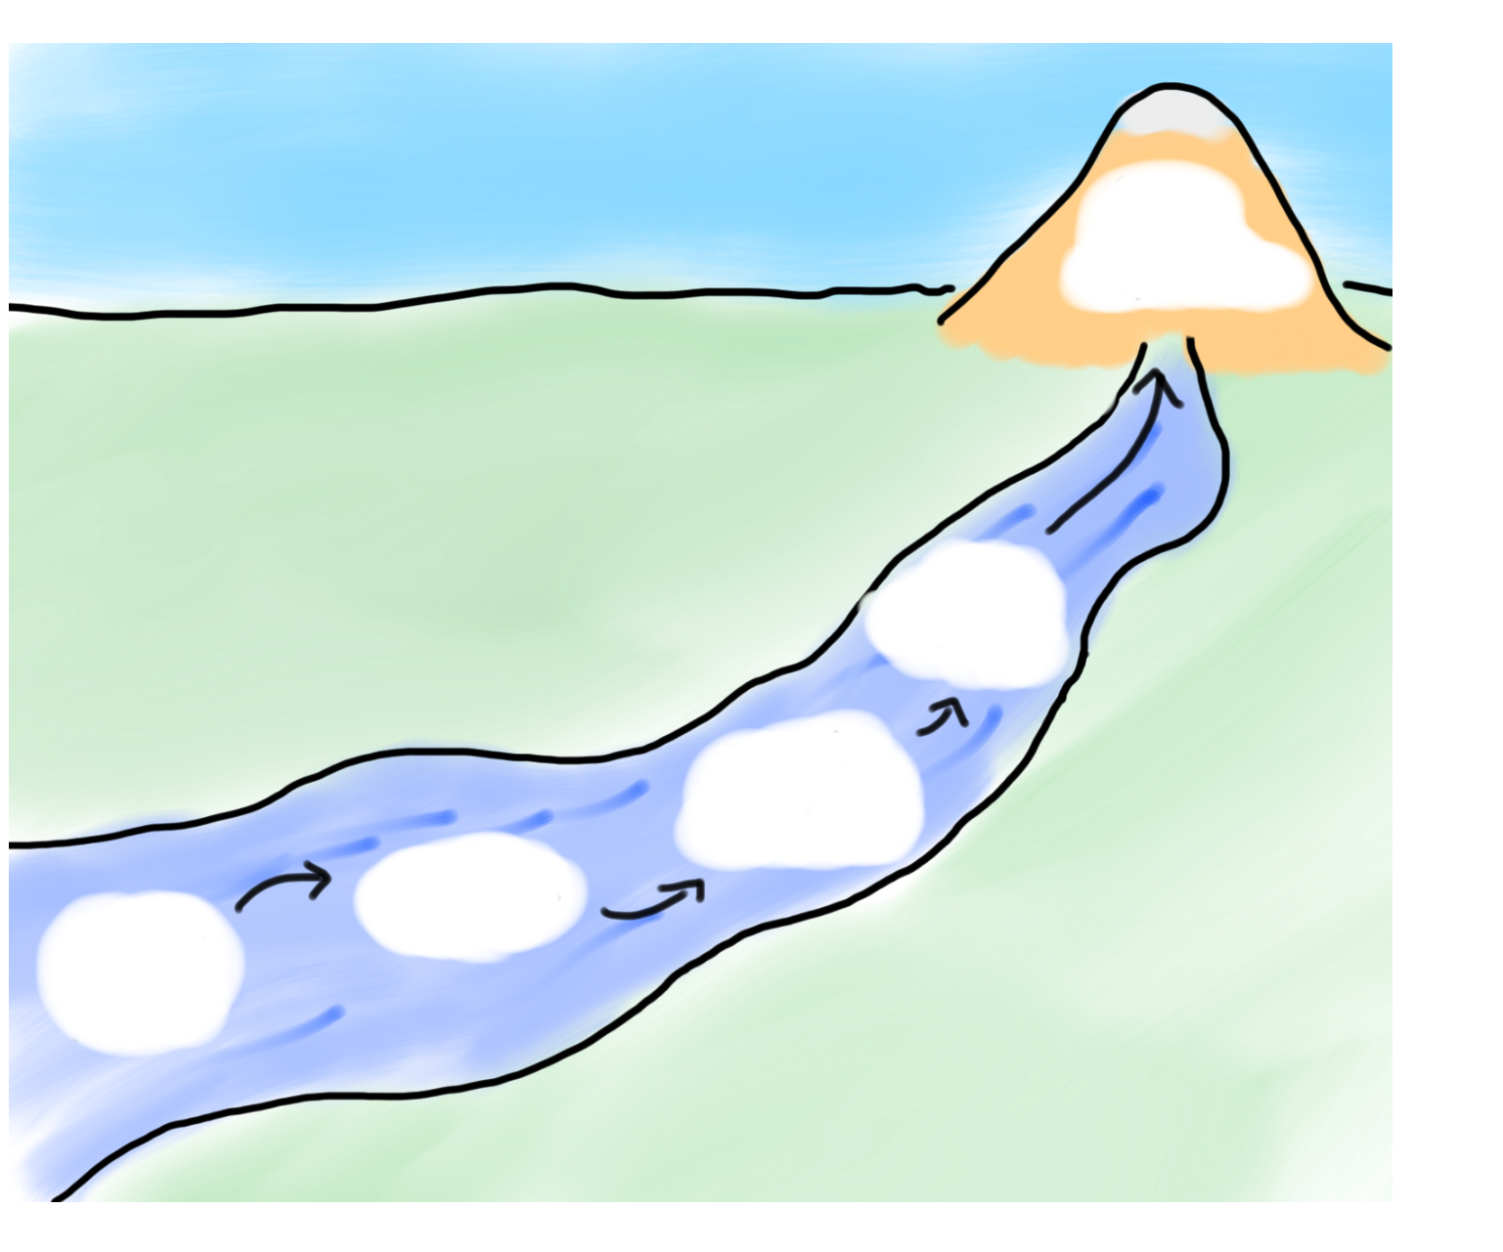

Today’s Goals
Monday
Linked
Lists
Stack?
Vector
Big O
River of Linked Lists
Dynamic
Allocation

Slide 9

How is the Stack Implemented?

Slide 10
Lets Write Vector

Slide 11
VectorInt
class VectorInt { // in VectorInt.h
public:
VectorInt(); // constructor
void add(int value); // append a value to the end
int get(int index); // return the value at index
private:
type name; // member variables
type name; // (data inside each object)
};

Slide 12

Buggy VectorInt the First
class VectorInt { // in VectorInt.h
public:
VectorInt(); // constructor
void add(int value); // append a value to the end
int get(int index); // return the value at index
private:
int value0; // member variables
int value1; // (data inside each object)
};

Slide 13
Problems with Stack Variables
Variables have to be known at compile time. Not runtime.

Slide 14
Problems with Stack Variables
Variables have to be known at compile time. Not runtime.
Its hard to share a single large object between classes.
Persistence is out of our control.

Slide 15
Dynamic Allocation!

Slide 16
Pointers
// dynamically request memory for a new GImage.
// calls the constructor.
// store the address of the new GImage.
GImage * image = new GImage(“cat.png”);

Slide 17
Pointers
// dynamically request memory for a new GImage.
// calls the constructor.
// store the address of the new GImage.
GImage * image = new GImage(“cat.png”);

Slide 18

Pointers
// dynamically request memory for a new GImage.
// calls the constructor.
// store the address of the new GImage.
GImage * image = new GImage(“cat.png”);
124134

Slide 19
Pointers
// dynamically request memory for a new GImage.
// calls the constructor.
// store the address of the new GImage.
124134
GImage * image = new GImage(“cat.png”);
124134

Slide 20
Pointers
// dynamically request memory for a new GImage.
// calls the constructor.
// store the address of the new GImage.
124134
GImage * image = new GImage(“cat.png”);
124134

Slide 21
Pointers
// dynamically request memory for a new GImage.
// calls the constructor.
// store the address of the new GImage.
124134
GImage * image = new GImage(“cat.png”);
124134
image
124134

Slide 22
Pointers
// dynamically request memory for a new GImage.
// calls the constructor.
// store the address of the new GImage.
GImage * image = new GImage(“cat.png”);
124134
image
124134

Slide 23
Pointers
// dynamically request memory for a new GImage.
// calls the constructor.
// store the address of the new GImage.
GImage * image = new GImage(“cat.png”);
124134
image

Slide 24

Pointers Example

Slide 26
Pointers
// dynamically request memory for n integers.
// store the address of the provided ints.
int * intList = new int[n];
intList

Slide 27
How Does this Help?
Variables have to be known at compile time. Not runtime.
Its hard to share a single large object between classes.
Persistence is out of our control.

Slide 28
Dig deeper

Slide 29
All Memory Has an Address
00000
00001
RAM not disk
00002
00003
Each program gets it’s own
99996
99997
99998
99999

Slide 30

URL Metaphore
A pointer is like a URL. Not the actual page, the address of the page

Slide 31
Socrative
Point * megan = new Point();
megan->setX(10);
Point * student = megan;
student->setY(7);
cout << student->getX();
cout << “ “;
cout << student->getY();
a) 10, 7
b) crashes
c) ?, 7
d) ? ?

Slide 32
Socrative
Point * megan = new Point();
megan->setX(10);
Point * student = megan;
student->setY(7);
cout << student->getX();
cout << “ “;
cout << student->getY();
a) 10, 7
b) crashes
c) ?, 7
d) ? ?

Slide 33
Socrative
Point * megan = new Point();
megan->setX(10);
Point * student = megan;
student->setY(7);
cout << student->getX();
cout << “ “;
cout << student->getY();
a) 10, 7
b) crashes
c) ?, 7
d) ? ?
megan
12634
x
12634
y

Slide 34
Socrative
Point * megan = new Point();
megan->setX(10);
Point * student = megan;
student->setY(7);
cout << student->getX();
cout << “ “;
cout << student->getY();
a) 10, 7
b) crashes
c) ?, 7
d) ? ?
megan
12634
x
12634
10
y

Slide 35
Socrative
Point * megan = new Point();
megan->setX(10);
Point * student = megan;
student->setY(7);
cout << student->getX();
cout << “ “;
cout << student->getY();
a) 10, 7
b) crashes
c) ?, 7
d) ? ?
megan
12634
x
12634
10
student
y
12634

Slide 36
Socrative
Point * megan = new Point();
megan->setX(10);
Point * student = megan;
student->setY(7);
cout << student->getX();
cout << “ “;
cout << student->getY();
a) 10, 7
b) crashes
c) ?, 7
d) ? ?
megan
12634
x
12634
10
student
7
y
12634

Slide 37
Socrative
Point * megan = new Point();
megan->setX(10);
Point * student = megan;
student->setY(7);
cout << student->getX();
cout << “ “;
cout << student->getY();
a) 10, 7
b) crashes
c) ?, 7
d) ? ?
megan
12634
x
12634
10
student
7
y
12634

Slide 38
Socrative
Point * megan = new Point();
megan->setX(10);
Point * student = megan;
student->setY(7);
cout << student->getX();
cout << “ “;
cout << student->getY();
a) 10, 7
b) crashes
c) ?, 7
d) ? ?
megan
x
12634
10
student
7
y

Slide 40
VectorInt
class VectorInt { // in VectorInt.h
public:
VectorInt(); // constructor
void add(int value); // append a value to the end
int get(int index); // return the value at index
private:
type name; // member variables
type name; // (data inside each object)
};

Slide 41
Actual Vector
class VectorInt { // in VectorInt.h
public:
VectorInt(); // constructor
void add(int value); // append a value to the end
int get(int index); // return the value at index
private:
int * data;
};

Slide 42
Actual Vector
class VectorInt { // in VectorInt.h
public:
VectorInt(); // constructor
void add(int value); // append a value to the end
int get(int index); // return the value at index
private:
int * data;
int size;
int allocatedSize;
};

Slide 43
Actual Vector
element
array
allocated
length
2
logical
length
0

Slide 44
Actual Vector
137
element
array
allocated
length
2
logical
length
1

Slide 45
Actual Vector
137
42
element
array
allocated
length
2
logical
length
2

Slide 46
Actual Vector
137
42
element
array
allocated
length
2
logical
length
2

Slide 47
Actual Vector
137
137
42
element
array
allocated
length
2
logical
length
2

Slide 48
Actual Vector
137
42
137
42
element
array
allocated
length
2
logical
length
2

Slide 49
Actual Vector
137
42
137
42
element
array
allocated
length
2
logical
length
2

Slide 50
Actual Vector
137
42
element
array
allocated
length
2
logical
length
2

Slide 51
Actual Vector
137
42
element
array
allocated
length
2
logical
length
2

Slide 52
Actual Vector
137
42
element
array
allocated
length
4
logical
length
2

Slide 53
Actual Vector
137
42
271
element
array
allocated
length
4
logical
length
3

Slide 54
Actual Vector
137
42
271
828
element
array
allocated
length
4
logical
length
4

Slide 55
Actual Vector
137
42
271
828
element
array
allocated
length
4
logical
length
4

Slide 56
Actual Vector
137
137
42
271
828
element
array
allocated
length
4
logical
length
4

Slide 57
Actual Vector
137
42
137
42
271
828
element
array
allocated
length
4
logical
length
4

Slide 58
Actual Vector
137
42
271
137
42
271
828
element
array
allocated
length
4
logical
length
4

Slide 59
Actual Vector
137
42
271
828
137
42
271
828
element
array
allocated
length
4
logical
length
4

Slide 60
Actual Vector
137
42
271
828
137
42
271
828
element
array
allocated
length
4
logical
length
4

Slide 61
Actual Vector
137
42
271
828
element
array
allocated
length
4
logical
length
4

Slide 62
Actual Vector
137
42
271
828
element
array
allocated
length
4
logical
length
4

Slide 63
Actual Vector
137
42
271
828
element
array
allocated
length
8
logical
length
4

Slide 64
Actual Vector
137
42
271
828
182
element
array
allocated
length
8
logical
length
5

Slide 65
Actual Vector
137
42
271
828
182
845
element
array
allocated
length
8
logical
length
6

Slide 66
Actual Vector
137
42
271
828
182
845
904
element
array
allocated
length
8
logical
length
7

Slide 67
Actual Vector
137
42
271
828
182
845
904
5
element
array
allocated
length
8
logical
length
8

Slide 68
Dynamic allocation was necessary

Slide 69
Benefits of Dynamic Allocation
Can decide on the number of variables at run time.
Control over variable lifespan
Its easy to share a single large object.

Slide 70
Today’s Goals
Monday
Linked
Lists
Stack?
Vector
Big O
River of Linked Lists
Dynamic
Allocation

Slide 71
Today’s Goals
Monday
Linked
Lists
Stack?
Vector
Big O
River of Linked Lists
Dynamic
Allocation

Slide 72
Vector Big O?

Slide 73
Big O of Get?
int VecInt::get(int index){
return data[index];
}

Slide 74
Big O of Get?

Slide 75

Big O of Get?

Slide 76
Add?

Slide 77
Big O of Add?
void VecInt::add(int v){
data[usedSize] = v;
usedSize++;
if(usedSize == allocatedSize) {
doubleAllocation();
}
}
void VecInt::doubleAllocation() {
allocatedSize *= 2;
int * newData = new int[allocatedSize];
for(int i = 0; i < usedSize; i++) {
newData[i] = data[i];
}
delete[] data;
data = newData;
}

Slide 78
Big O of Add?
void VecInt::add(int v){
data[usedSize] = v;
usedSize++;
if(usedSize == allocatedSize) {
doubleAllocation();
}
}
void VecInt::doubleAllocation() {
allocatedSize *= 2;
int * newData = new int[allocatedSize];
for(int i = 0; i < usedSize; i++) {
newData[i] = data[i];
}
delete[] data;
data = newData;
}
Worst Case

Slide 79
Big O of Add?
void VecInt::add(int v){
data[usedSize] = v;
usedSize++;
if(usedSize == allocatedSize) {
doubleAllocation();
}
}
void VecInt::doubleAllocation() {
allocatedSize *= 2;
int * newData = new int[allocatedSize];
for(int i = 0; i < usedSize; i++) {
newData[i] = data[i];
}
delete[] data;
data = newData;
}
Worst Case

Slide 80
Big O of Add?
void VecInt::add(int v){
data[usedSize] = v;
usedSize++;
if(usedSize == allocatedSize) {
doubleAllocation();
}
}
void VecInt::doubleAllocation() {
allocatedSize *= 2;
int * newData = new int[allocatedSize];
for(int i = 0; i < usedSize; i++) {
newData[i] = data[i];
}
delete[] data;
data = newData;
}
Worst Case

Slide 81
Big O of Add?
void VecInt::add(int v){
data[usedSize] = v;
usedSize++;
if(usedSize == allocatedSize) {
doubleAllocation();
}
}
void VecInt::doubleAllocation() {
allocatedSize *= 2;
int * newData = new int[allocatedSize];
for(int i = 0; i < usedSize; i++) {
newData[i] = data[i];
}
delete[] data;
data = newData;
}
Worst Case

Slide 82
Big O of Add?
void VecInt::add(int v){
data[usedSize] = v;
usedSize++;
if(usedSize == allocatedSize) {
doubleAllocation();
}
}
void VecInt::doubleAllocation() {
allocatedSize *= 2;
int * newData = new int[allocatedSize];
for(int i = 0; i < usedSize; i++) {
newData[i] = data[i];
}
delete[] data;
data = newData;
}
Worst Case

Slide 83
Big O of Add?

Slide 84
Remove?

Slide 85
Big O of Remove?
void VecInt::remove(int index){
for(int i = index; i < usedSize - 1; i++) {
data[i] = data[i + 1];
}
usedSize--;
}

Slide 86
Big O of Remove?

Slide 87
Summary?

Slide 88
Vector Big O
Get
Add
Remove

Slide 89
That’s fine.

Slide 90
How is the Stack Implemented?

Slide 91
Today’s Goals
Monday
Linked
Lists
Stack?
Vector
Big O
River of Linked Lists
Dynamic
Allocation

Slide 92
Today’s Goals
Monday
Linked
Lists
Stack?
Vector
Big O
River of Linked Lists
Dynamic
Allocation

Slide 93
VectorInt
class StackInt { // in VectorInt.h
public:
StackInt (); // constructor
void push(int value); // append a value to the end
int pop(); // return the value at index
private:
VectorInt data; // member variables
};

Slide 94
Excuse Me, Coming Through
1
1
2
2
3
3
4
4
5
6
7

Slide 95
Excuse Me, Coming Through
1
1
2
2
3
3
4
4
5
6
7
137

Slide 96
Excuse Me, Coming Through
1
1
2
2
3
3
4
4
5
6
7
7
137

Slide 97
Excuse Me, Coming Through
1
1
2
2
3
3
4
4
5
6
6
7
137

Slide 98
Excuse Me, Coming Through
1
1
2
2
3
3
4
4
5
5
6
7
137

Slide 99
Excuse Me, Coming Through
1
1
2
2
3
3
4
4
4
5
6
7
137

Slide 100
Excuse Me, Coming Through
1
1
2
2
3
3
4
3
4
5
6
7
137

Slide 101
Excuse Me, Coming Through
1
1
2
2
3
2
4
3
4
5
6
7
137

Slide 102
Excuse Me, Coming Through
1
1
2
1
3
2
4
3
4
5
6
7
137

Slide 103
Excuse Me, Coming Through
1
137
2
1
3
2
4
3
4
5
6
7

Slide 104
Stack as Vector Big O
Push
Pop

Slide 105
There’s always a better way

Slide 106
What About This?
push(7);
int *
data
8
9

Slide 107
What About This?
push(7);
int *
data
8
9
7

Slide 108
What About This?
push(7);
int *
data
8
9
7

Slide 109
What About This?
push(7);
int *
data
8
9
7

Slide 110
Oh Cool

Slide 111
What About This?
push(6);
int *
data
8
9
7

Slide 112
What About This?
push(6);
int *
data
8
9
7
6

Slide 113
What About This?
push(6);
int *
data
8
9
7
6

Slide 114
What About This?
push(6);
int *
data
8
9
7
6

Slide 115
What About This?
push(6);
int *
data
8
9
7
6

Slide 116
And Pop?

Slide 117
What About This?
pop();
int *
data
8
9
7
6

Slide 118
What About This?
pop();
int *
data
8
9
int return
7
6
6

Slide 119
What About This?
pop();
int *
data
8
9
int return
7
6
6

Slide 120
What About This?
pop();
int *
data
8
9
int return
7
6

Slide 121
What About This?
pop();
int *
data
8
9
int return
7
6

Slide 122
Linked Lists!

Slide 123
Today’s Goals
Monday
Linked
Lists
Stack?
Vector
Big O
River of Linked Lists
Dynamic
Allocation

Slide 124
Today’s Goals
Monday
Linked
Lists
Stack?
Vector
Big O
River of Linked Lists
Dynamic
Allocation

Slide 125
Linked Lists
A linked list is a data structure for storing a sequence of elements.
Each element is stored separately from the rest.
The elements are then chained together into a sequence.
1
2
3

Slide 126
Linked Lists
A linked list is a data structure for storing a sequence of elements.
Each element is stored separately from the rest.
The elements are then chained together into a sequence.
1
2
3
4

Slide 127
Linked Lists
A linked list is a data structure for storing a sequence of elements.
Each element is stored separately from the rest.
The elements are then chained together into a sequence.
1
2
3
4

Slide 128
Linked Lists
A linked list is a data structure for storing a sequence of elements.
Each element is stored separately from the rest.
The elements are then chained together into a sequence.
1
2
3
4

Slide 129
Linked Lists
A linked list is a data structure for storing a sequence of elements.
Each element is stored separately from the rest.
The elements are then chained together into a sequence.
1
2
137
3
4

Slide 130
Linked Lists
A linked list is a data structure for storing a sequence of elements.
Each element is stored separately from the rest.
The elements are then chained together into a sequence.
1
137
3
4

Slide 131
Linked Lists
Can efficiently splice new elements into the list or remove existing elements anywhere in the list.
Never have to do a massive copy step; insertion is efficient in the worst-case.
Has some tradeoffs; we'll see this later.

Slide 132
Linked Lists
In order to use linked lists, we will need to introduce or revisit several new language features:
Structures
Dynamic allocation
Null pointers

Slide 133
Linked Lists
In order to use linked lists, we will need to introduce or revisit several new language features:
Structures
Dynamic allocation
Null pointers

Slide 134
Structs
In C++, a structure is a type consisting of several individual variables all bundled together.
To create a structure, we must
Define what fields are in the structure, then
Create a variable of the appropriate type.
Similar to using classes – need to define and implement the class before we can use it.

Slide 135
Structs
You can define a structure by using the struct keyword:
struct TypeName {
/* … field declarations … */
};
For those of you with a C background: in C++, “typedef struct” is not necessary.

Slide 136
Structs
struct Tribute {
string name;
int districtNumber;
};
Tribute t;
t.name = "Katniss Everdeen";
t.districtNumber = 12;

Slide 137
Structs
struct Tribute {
string name;
int districtNumber;
};
Tribute t;
t.name = "Katniss Everdeen";
t.districtNumber = 12;

Slide 138
Structs
struct Tribute {
string name;
int districtNumber;
};
Tribute t;
t.name = "Katniss Everdeen";
t.districtNumber = 12;

Slide 139
Structs
In C++, a class is a pair of an interface and an implementation.
Interface controls how the class is to be used.
Implementation specifies how it works.
A struct is a stripped-down version of a class:
Purely implementation, no interface.
Primarily used to bundle information together when no interface is needed.

Slide 140
Structs
In order to use linked lists, we will need to introduce or revisit several new language features:
Structures
Dynamic allocation
Null pointers

Slide 141
Structs
In order to use linked lists, we will need to introduce or revisit several new language features:
Structures
Dynamic allocation
Null pointers

Slide 142
Structs
We have seen the new keyword used to allocate arrays, but it can also be used to allocate single objects.
The syntax:
new T(args)
creates a new object of type T passing the appropriate arguments to the constructor, then returns a pointer to it.

Slide 143
Structs
struct Tribute {
string name;
int districtNumber;
};
Tribute* t = new Tribute;
t->name = "Katniss Everdeen";
t->districtNumber = 12;

Slide 144
Structs
struct Tribute {
string name;
int districtNumber;
};
Tribute* t = new Tribute;
t->name = "Katniss Everdeen";
t->districtNumber = 12;

Slide 145
Structs
struct Tribute {
string name;
int districtNumber;
};
Tribute* t = new Tribute;
t->name = "Katniss Everdeen";
t->districtNumber = 12;
t

Slide 146
Structs
struct Tribute {
string name;
int districtNumber;
};
Tribute* t = new Tribute;
t->name = "Katniss Everdeen";
t->districtNumber = 12;
name
????
districtNumber
t

Slide 147
Structs
struct Tribute {
string name;
int districtNumber;
};
Tribute* t = new Tribute;
t->name = "Katniss Everdeen";
t->districtNumber = 12;
name
????
districtNumber
t

Slide 148
Structs
struct Tribute {
string name;
int districtNumber;
};
Tribute* t = new Tribute;
t->name = "Katniss Everdeen";
t->districtNumber = 12;
name
????
districtNumber
t

Slide 149
Structs
struct Tribute {
string name;
int districtNumber;
};
Tribute* t = new Tribute;
t->name = "Katniss Everdeen";
t->districtNumber = 12;
name
????
districtNumber
t

Slide 150
Structs
Because t is a pointer to a Tribute, not an actual Tribute, we have to use the arrow operator to access the fields pointed at by t.
struct Tribute {
string name;
int districtNumber;
};
Tribute* t = new Tribute;
t->name = "Katniss Everdeen";
t->districtNumber = 12;
name
????
districtNumber
t

Slide 151
Structs
struct Tribute {
string name;
int districtNumber;
};
Tribute* t = new Tribute;
t->name = "Katniss Everdeen";
t->districtNumber = 12;
name
????
districtNumber
t

Slide 152
Structs
struct Tribute {
string name;
int districtNumber;
};
Tribute* t = new Tribute;
t->name = "Katniss Everdeen";
t->districtNumber = 12;
Katniss Everdeen
name
????
districtNumber
t

Slide 153
Structs
struct Tribute {
string name;
int districtNumber;
};
Tribute* t = new Tribute;
t->name = "Katniss Everdeen";
t->districtNumber = 12;
Katniss Everdeen
name
????
districtNumber
t

Slide 154
Structs
struct Tribute {
string name;
int districtNumber;
};
Tribute* t = new Tribute;
t->name = "Katniss Everdeen";
t->districtNumber = 12;
Katniss Everdeen
name
12
districtNumber
t

Slide 155
Structs
As with dynamic arrays, you are responsible for cleaning up memory allocated with new.
You can deallocate memory with the delete keyword:
delete ptr;
This destroys the object pointed at by the given pointer, not the pointer itself.
137
ptr

Slide 156
Structs
As with dynamic arrays, you are responsible for cleaning up memory allocated with new.
You can deallocate memory with the delete keyword:
delete ptr;
This destroys the object pointed at by the given pointer, not the pointer itself.
137
ptr

Slide 157
Building our Vocabulary
In order to use linked lists, we will need to introduce or revisit several new language features:
Structures
Dynamic allocation
Null pointers

Slide 158
Building our Vocabulary
In order to use linked lists, we will need to introduce or revisit several new language features:
Structures
Dynamic allocation
Null pointers

Slide 159
The Null Pointer
When working with pointers, we sometimes wish to indicate that a pointer is not pointing to anything.
In C++, you can set a pointer to NULL to indicate that it is not pointing to an object:
ptr = NULL;
This is not the default value for pointers; by default, pointers default to a garbage value.

Slide 160
Building our Vocabulary
In order to use linked lists, we will need to introduce or revisit several new language features:
Structures
Dynamic allocation
Null pointers

Slide 161
Building our Vocabulary
In order to use linked lists, we will need to introduce or revisit several new language features:
Structures
Dynamic allocation
Null pointers

Slide 162
And now... linked lists!

Slide 163
Linked Lists
A linked list is a chain of cells.
Each cell contains two pieces of information:
Some piece of data that is stored in the sequence, and
A link to the next cell in the list.
We can traverse the list by starting at the first cell and repeatedly following its link.

Slide 164
Linked Lists
For simplicity, let's assume we're building a linked list of strings.
We can represent a cell in the linked list as a structure:
struct Cell {
string value;
/* ? */ next;
};
The structure is defined recursively!

Slide 165
Linked Lists
For simplicity, let's assume we're building a linked list of strings.
We can represent a cell in the linked list as a structure:
struct Cell {
string value;
Cell* next;
};
The structure is defined recursively!

Slide 166
Linked Lists
For simplicity, let's assume we're building a linked list of strings.
We can represent a cell in the linked list as a structure:
struct Cell {
string value;
Cell* next;
};
The structure is defined recursively!

Slide 167
Building Linked Lists!

Slide 168
Today’s Goals
Monday
Linked
Lists
Stack?
Vector
Big O
River of Linked Lists
Dynamic
Allocation

Slide 169
Today’s Goals
Monday
Linked
Lists
Stack?
Vector
Big O
River of Linked Lists
Dynamic
Allocation

Slide 170
Today’s Goals
Practice with dynamic allocation
Introduction to linked lists

